Slide 1
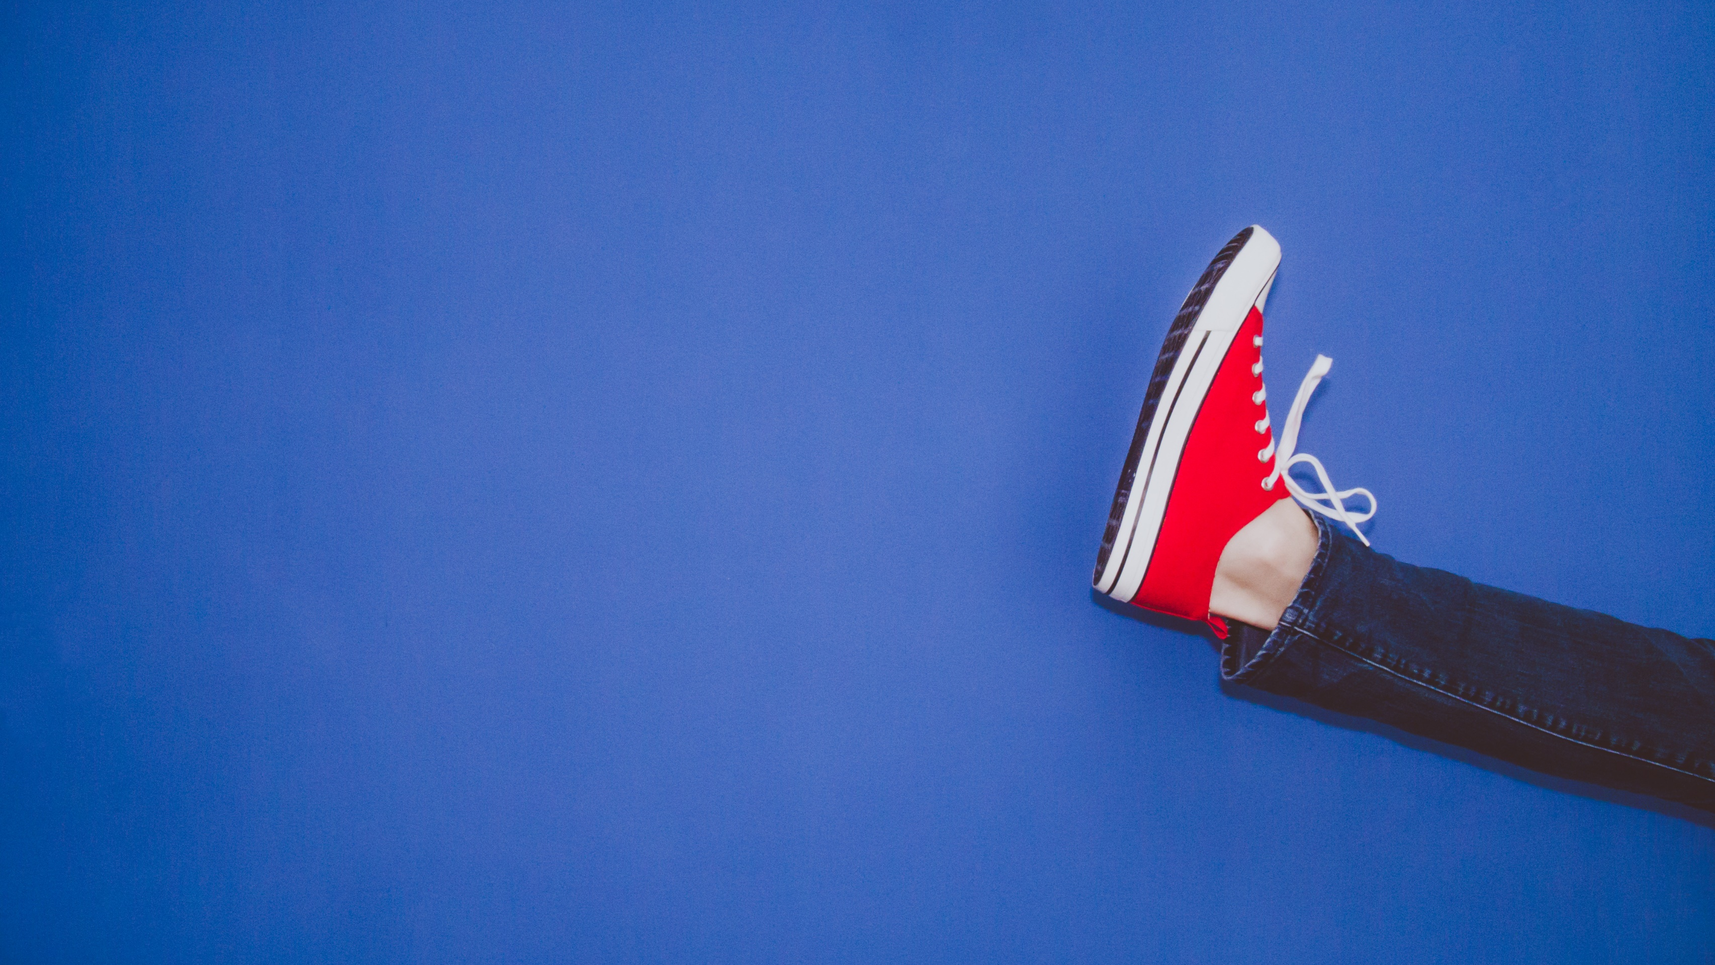
Stand in My Shoes
Eve Hill

Slide 2
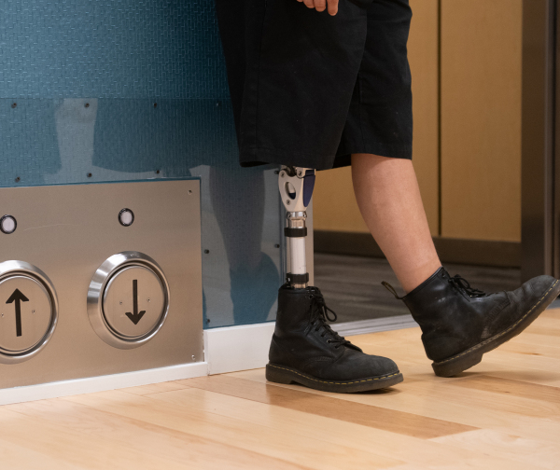
Stand in My Shoes
Example Exercise
10 Participants

Slide 3
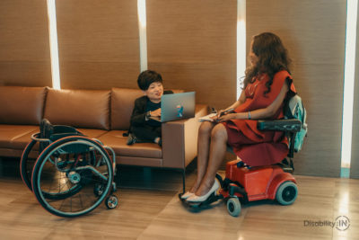
Disability | Most Preferred | Least Preferred
Blind | 1 | 3
Deaf | 3 | 1
Seizure Disorder | 4 | 0
Paraplegia | 2 | 4
Intellectual Disability | 0 | 2

